Slide 1
Big Data Storage
Dr. Ahmed Awais
Notes:
https://www.linkedin.com/pulse/exploring-apache-big-data-technologies-hadoop-spark-flink-itwbf/

Slide 2
Outline
Big Data Storage Technologies
On-Disk Storage Devices
In-Memory Storage Devices (maybe next lecture)
Storage Types Differences

Slide 3
The background
Storage technology has changed over time, moving from inside the server to out on the network. Today's push for converged architecture puts compute, storage, memory, and network back into the box, where the architecture can be uniformly managed. Amidst these changes, the need to store Big Data has radically changed the relational, database-centric view that has been embraced by Enterprise ICT since the late 1980s. The bottom line is that relational technology is simply not scalable in a manner to support Big Data volumes. Not to mention, businesses can find genuine value in processing semi-structured and unstructured data, which are generally incompatible with relational approaches.

Slide 4
The background
Big Data has pushed the storage boundary to unified views of the available memory and disk storage of a cluster. If more storage is needed, horizontal scalability allows the expansion of the cluster through the addition of more nodes. The fact that this is equally true for both memory and disk devices is important as innovative approaches deliver realtime analytics via in-memory storage. Even batch-based processing has accelerated by the performance of Solid State Drives (SSDs), which have become less expensive.

Slide 5
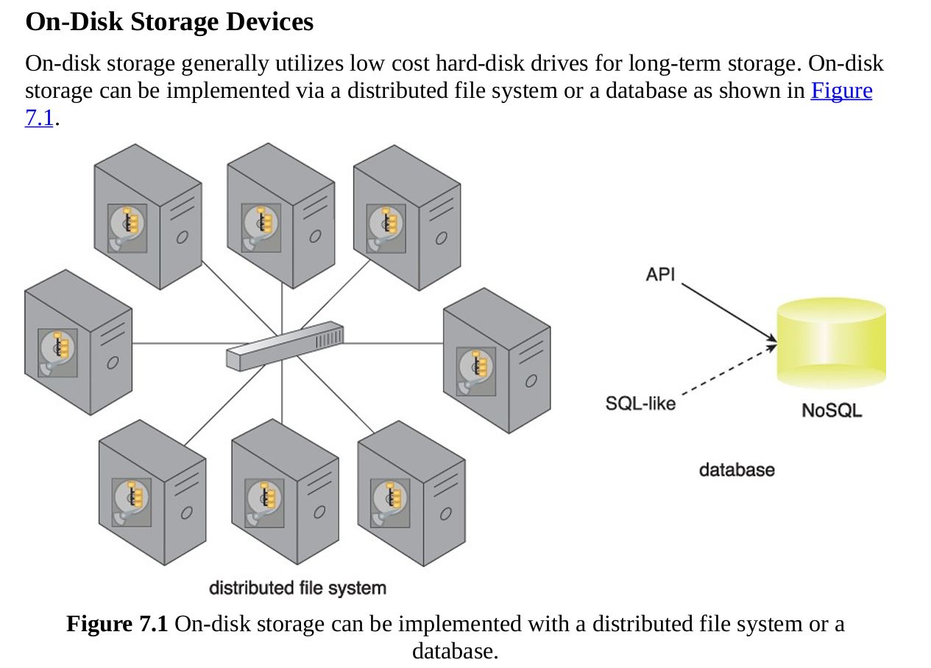
On-DISK

Slide 6
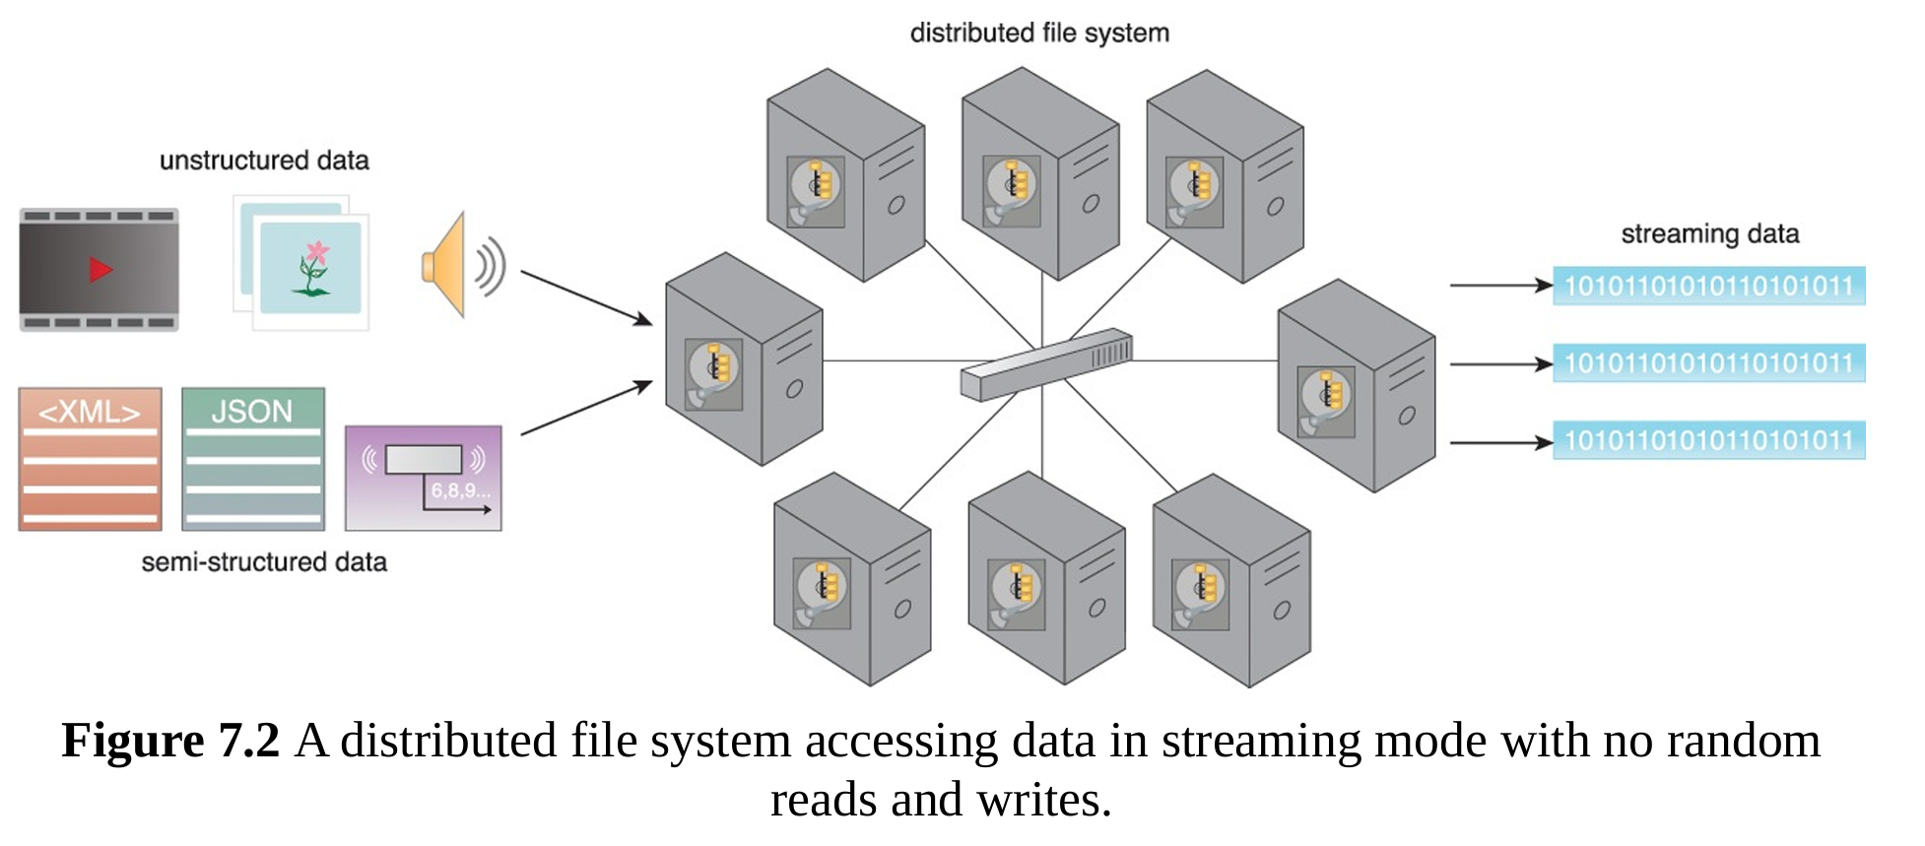
DFS prefer to have fewer larger size rather more small size - why?
On-DISK

Slide 7
RDBMS - Reading from book directly
On-DISK

Slide 8
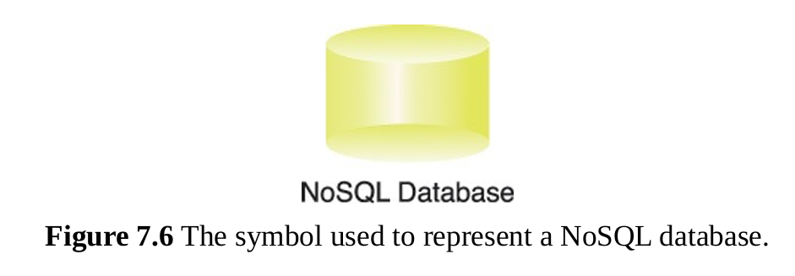
NoSQL Databases
On-DISK
The emergence of NoSQL storage devices can primarily be attributed to the volume, velocity and variety characteristics of Big Data datasets.
Not-only SQL (NoSQL) refers to technologies used to develop next generation non relational databases that are highly scalable and fault-tolerant.

Slide 9
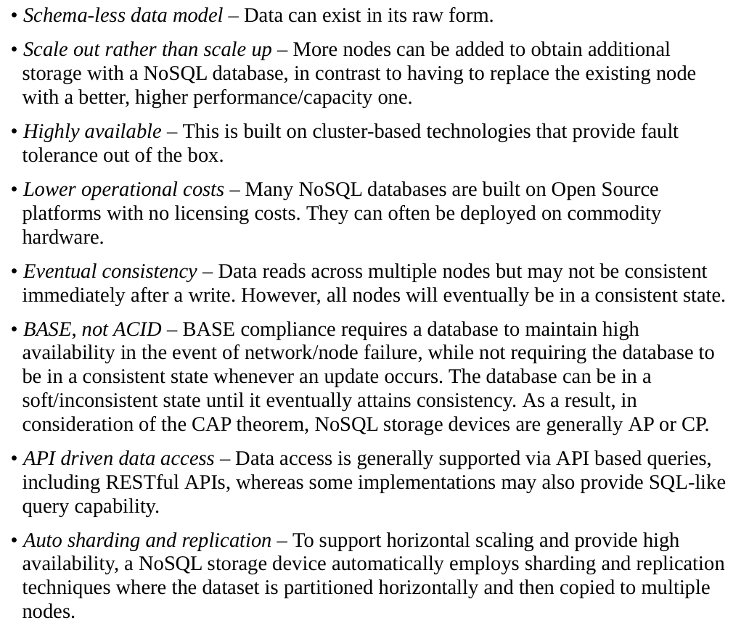
NoSQL Databases
On-DISK
List of the principal features of NoSQL storage devices that differentiate them from traditional RDBMSs.
This list should only be considered a general guide, as not all NoSQL storage devices exhibit all of these features.

Slide 10
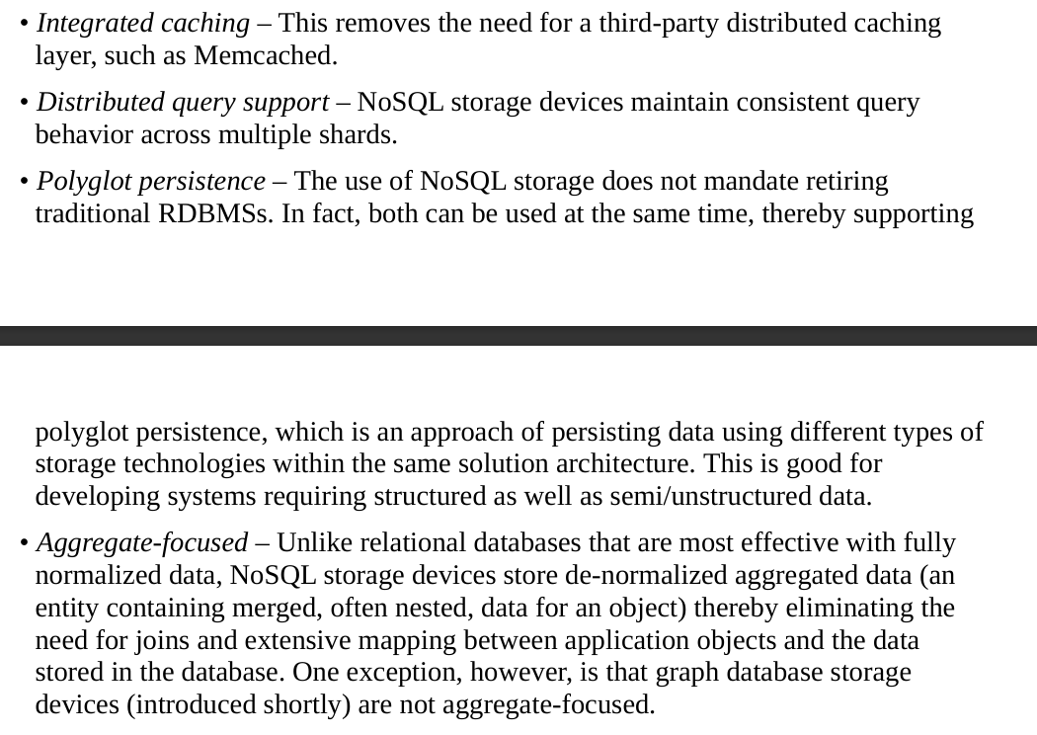
NoSQL Databases
On-DISK
List of the principal features of NoSQL storage devices that differentiate them from traditional RDBMSs.
This list should only be considered a general guide, as not all NoSQL storage devices exhibit all of these features.

Slide 11
NoSQL Databases
On-DISK
Types NoSQL storage devices can mainly be divided into four types based on the way they store data, as shown in Figures 7.7–7.10:
• key-value • document • column-family • graph - Let’s visit textbook to interpret figures and further reading is also recommended for better understanding

Slide 12
Next lecture
In-Memory

Slide 13
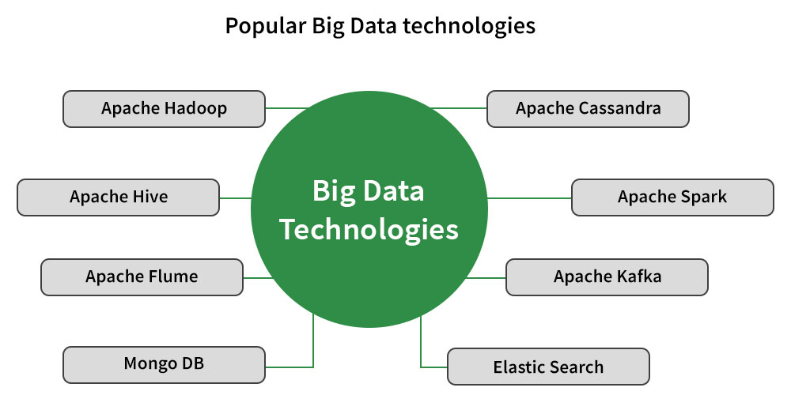
The background

Slide 14
Database vs Data Warehouse vs Data Lakes
Databases, data warehouses, and data lakes serve distinct purposes in data storage. Databases handle real-time transactions, data warehouses analyze historical data for insights, and data lakes store diverse data types for future analysis. Choosing the right tool depends on specific needs, with many organizations using a combination of these solutions.
What are the main differences between databases and data warehouses?
When should I use a data lake over a data warehouse?
How does a data lakehouse differ from a traditional data lake?

Slide 15
Database vs Data Warehouse vs Data Lakes
Databases are structured collections of data, typically organized into tables for efficient online transactional processing. They can be relational or non-relational, each serving distinct data needs.
Data warehouses are specialized databases designed for analytical purposes, allowing businesses to analyze trends and generate reports over time. They store historical data for better decision-making.
Data lakes differ from databases and warehouses by storing vast amounts of raw data in its native format. This flexibility allows for diverse data types and analytics applications.

Slide 16
Database vs Data Warehouse vs Data Lakes
A data warehouse is designed to store structured information from multiple sources for analytical purposes, enabling the creation of insightful reports. It facilitates comprehensive analysis, uncovering insights and supporting strategic decision-making.
Data warehouses consolidate information from various systems, acting as a centralized repository. This allows businesses to analyze trends and generate valuable business intelligence。
The process of moving data into a warehouse is known as ETL, which stands for extract, transform, and load. This process ensures data is formatted correctly for analysis.
Methodology includes several designs such as: Star Schema
These strategies enhance the efficiency of reporting and data retrieval.

Slide 17
Database vs Data Warehouse vs Data Lakes
A data lake is a centralized storage repository that preserves data in its original format, unlike structured databases or data warehouses. This enables advanced analytics and exploration of diverse data types for data scientists.
Data lakes accommodate various data formats, including structured and unstructured data, making them suitable for machine learning and artificial intelligence applications. This versatility is crucial for modern data analysis.
Microsoft has introduced innovations such as One Lake, a unified data lake that simplifies connectivity across Microsoft products, enhancing collaboration and efficiency within organizations.
The concept of a data lakehouse merges the benefits of data lakes and data warehouses, providing flexibility along with effective data management and transaction capabilities for organizations.
Can I say?
datalake can be a folder on a disk?
or folder on share point?
Excel document with multiple sheets

Slide 18
Which one to Choose

Slide 19
Which one to Choose
Choosing the right data storage method is crucial for effective business operations. Each method, including databases, data warehouses, and data lakes, serves distinct purposes based on specific needs.
__________________ ideal for managing day-to-day transactions and operational efficiency, such as recording purchases in an online store. They support real-time tracking of inventory and sales.
_________________ are best suited for analyzing historical data and generating business insights. They are often integrated with business intelligence tools for reporting and dashboarding.
__________________ offer a flexible solution for storing diverse data types in raw form, making future analysis easier. They can handle both structured and unstructured data like customer feedback.

